Slide 1

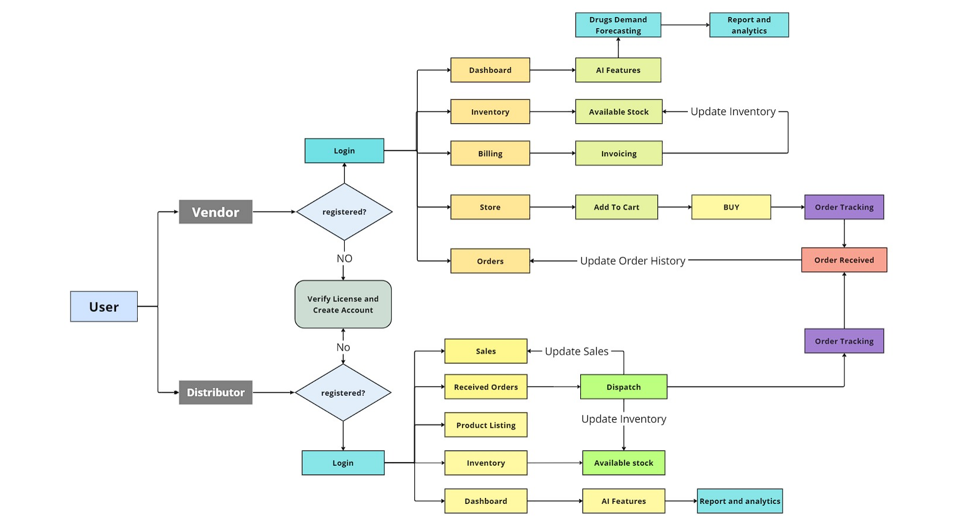
Drugs Supply Chain Tracking System
Problem Statement ID – SIH1627
Problem Statement Title- Drug Inventory and Supply Chain Tracking System
Theme- MedTech / BioTech / HealthTech
Team Laksh Members:
Rohit Kuber
Aditya Warungase
Krushna Kasar
Khushi Mehata
Vedant Jadhav
Jayesh Salunke
How the Solution Addresses the Problem:
Ensures Drug Availability
Improves Procurement Efficiency
Monitors Drug Consumption Patterns
Reduces Costs and Waste
Improves Data Security
Enhances Regulatory Compliance
Innovation and Uniqueness of the Solution:
Integrated Multi-Database Approach
Real-Time Dashboard Monitoring
Focus on Data-Driven Decisions
Enhanced Security with Modern Protocols
AI based Forecasting
Ecommerce platform
WORKFLOW

